Slide 2


Slide 3
“What, after all, is Apollos? And what is Paul? Only servants, through whom you came to believe—as the Lord has assigned to each his task. I planted the seed, Apollos watered it, but God made it grow. So neither he who plants nor he who waters is anything, but only God, who makes things grow…

Slide 4
“The man who plants and the man who waters have one purpose, and each will be rewarded according to his own labor. For we are God's fellow workers; you are God's field, God's building.”
1 Corinthians 3:5-9, NIV

Slide 5
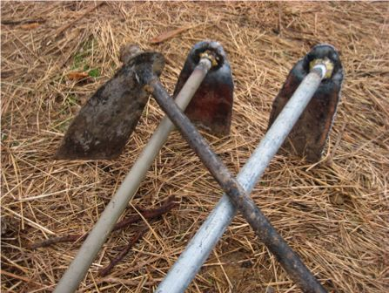
Chabadza
Working Together
A cultural expectation to work alongside your neighbour in his field.
The owner of the field has a second badza, and when you pass by, you must join him in his field.

Slide 6
The Principle of Alignment
In writing to the church in Corinth, Paul reminds us that mission work is God’s work. God told the church in Antioch to set apart Paul and Barnabas for the “work to which [he had] called them” (Acts 13:2, NIV).
Our tendency is to pray for great “outcomes” as we do our work. However, when Jesus prayed, His mind was focused on “alignment” to God’s work:
Not what I will, but what You will.
“Alignment” calls us to surrender to what God is doing, in contrast to what we think God should do or what we want to do.

Slide 7
J. Roswell Flower, first editor of The Pentecostal Evangel,
wrote in 1914:
  “When the Holy Spirit comes into our hearts, the missionary spirit comes in with it; they are inseparable, as the missionary spirit is but one of the fruits of the Holy Spirit. Carrying the gospel to hungry souls in this and other lands is but a natural result of receiving the baptism of the Holy Spirit.”

Slide 8
The Missionary Impulse
The Pentecostal movement has been marked by people with a passion, an “ambition to preach the gospel where Christ was not known” (Romans 15:20).
A deep-seated missionary impulse from the Holy Spirit.
Pentecostalism and mission belong together and you cannot understand the DNA and history of our Fellowship without understanding its missionary vision and work.

Slide 9
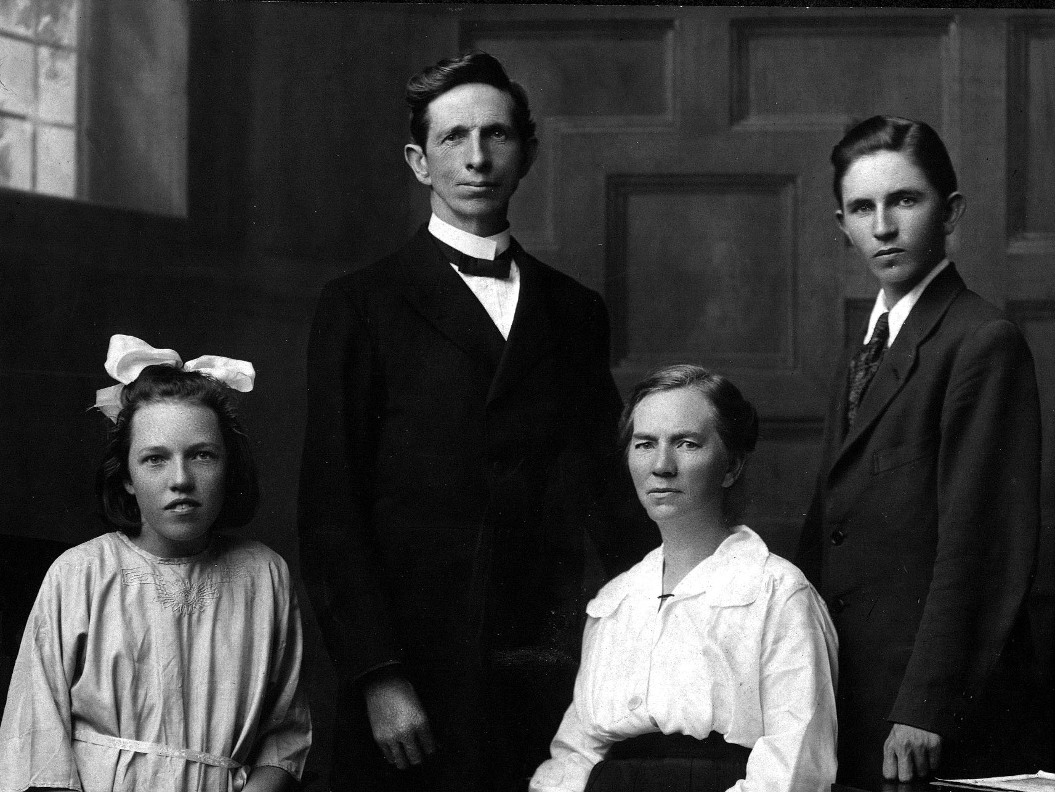
Missional DNA has shaped the PAOC
In 1908, 11 years before The Pentecostal Assemblies of Canada (PAOC) organized as a Fellowship of affiliated self-governing churches, two families left Toronto for the mission field; Charles and Emma Chawner to South Africa and Arthur and Jessie Atter to China.

Slide 10
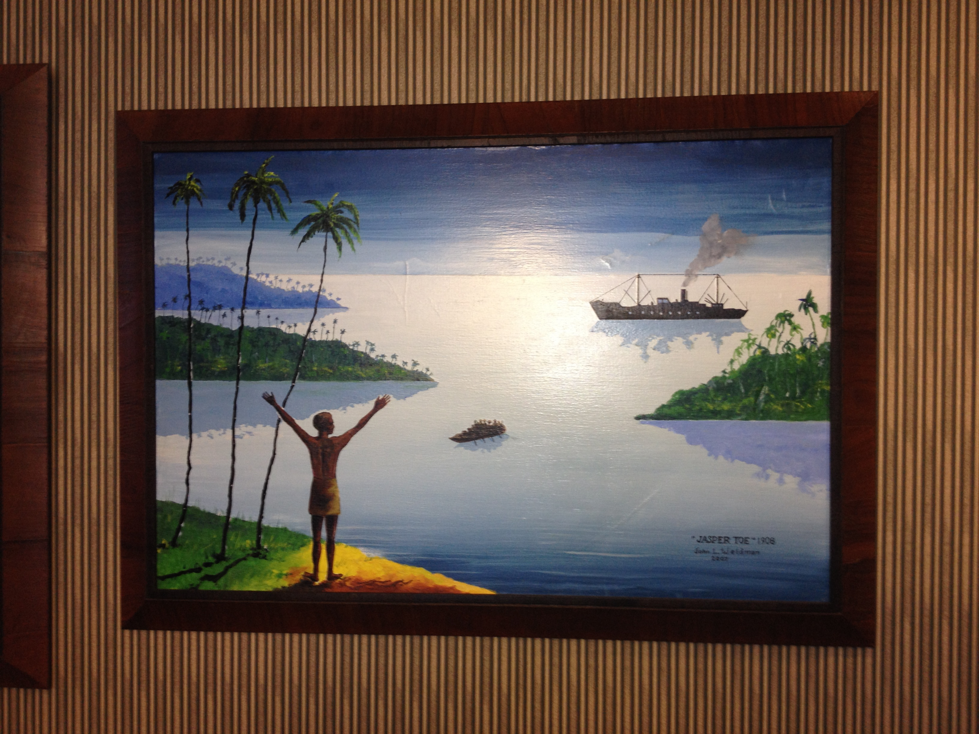
These pioneers were soon followed by workers to
Liberia (1910)
Egypt and India (1911)
Argentina (1913)
Tanganyika (1914)
Kenya and the West Indies (1918)
Over the last 110 years more than 3,000 Canadian Pentecostals have served as messengers of the gospel in over 80 countries.
Today there are 340 Canadian global workers serving in 75 countries around the world.

Slide 11
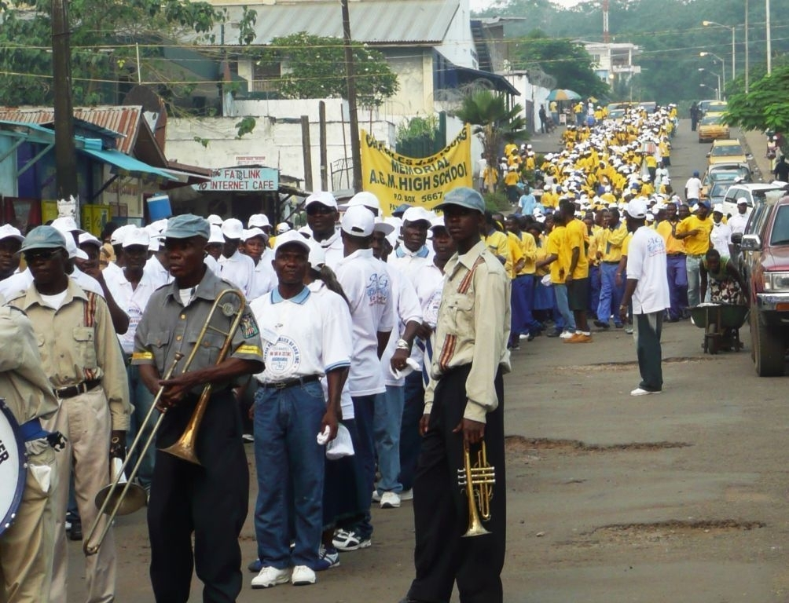
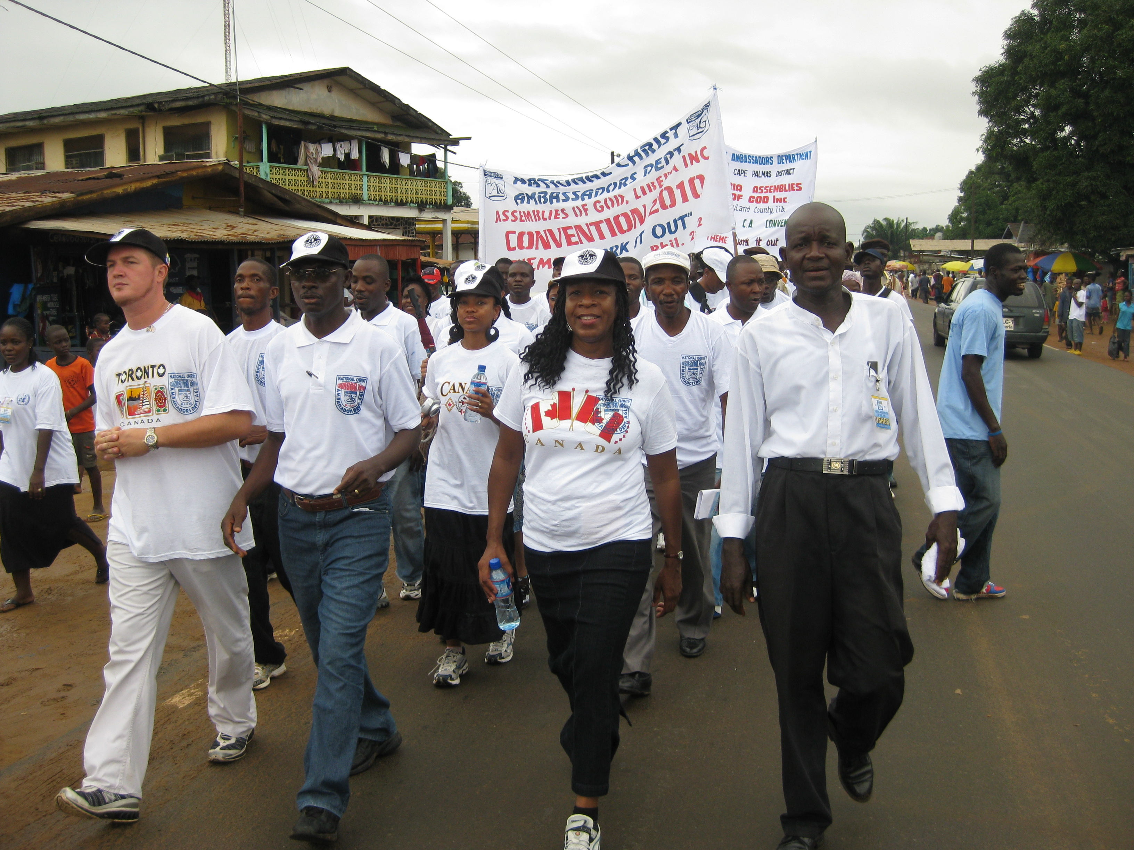

Slide 12
Together With God
Our PAOC international family includes
55 national fellowships
51,900 churches
12.2 million believers
40,000 national pastors

Slide 13
“All over the world this gospel is bearing fruit and growing, just as it has been doing among you since the day you heard it and understood
God’s grace in all its truth.”
Colossians 1:6, NIV

Slide 14
Together With God
We are currently engaged significantly in 20 international/urban church plants and have planted over 100 Great Commission churches in urban centres around the world.
We partner with four universities and 51 pastoral training centres with over 12,500 students and thousands of extension program students.
PAOC was instrumental in the founding of 27 of these partner training centres.

Slide 15
Together With God
8,000+ sponsored children.
Many ministries to the vulnerable and orphaned children.
Engaged significantly in disaster relief and food security in places such as Bangladesh, Somalia, South Sudan, and Zimbabwe.
Earthquake response in Haiti and Nepal.
Hurricane/cyclone response in the Philippines and the Caribbean.

Slide 16
3.1 billion

Slide 17
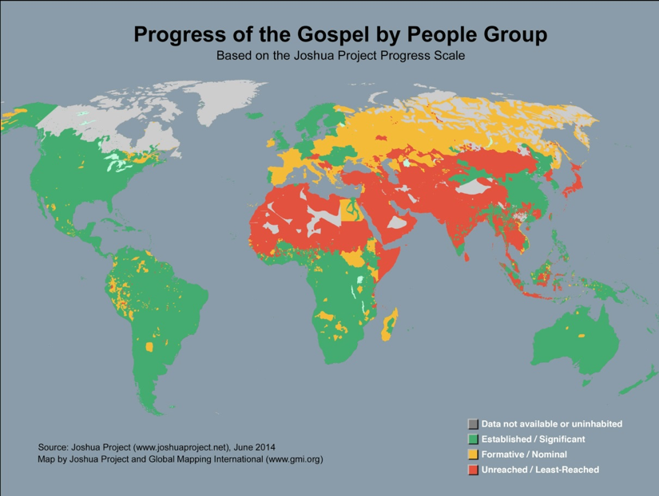

Slide 18
“My food,” said Jesus, “is to do the will of him who sent me and to finish his work. Do you not say, ‘Four months more and then the harvest’? I tell you, open your eyes and look at the fields! They are ripe for harvest.”
John 4:34-38, NIV

Slide 19
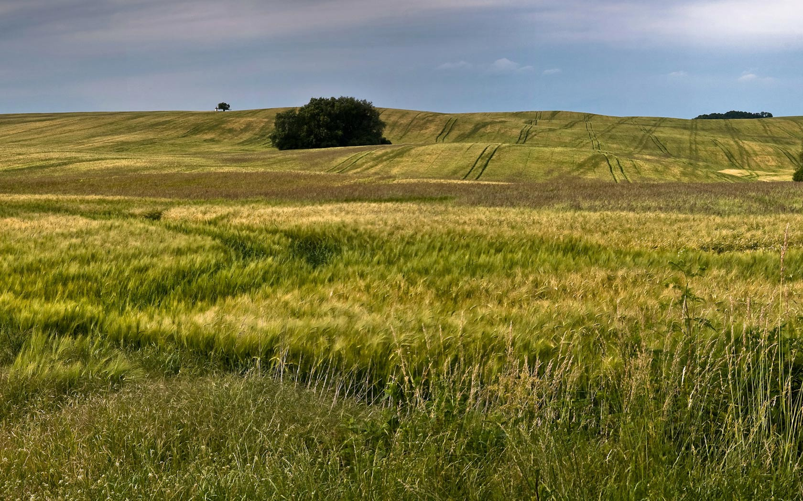

Slide 20
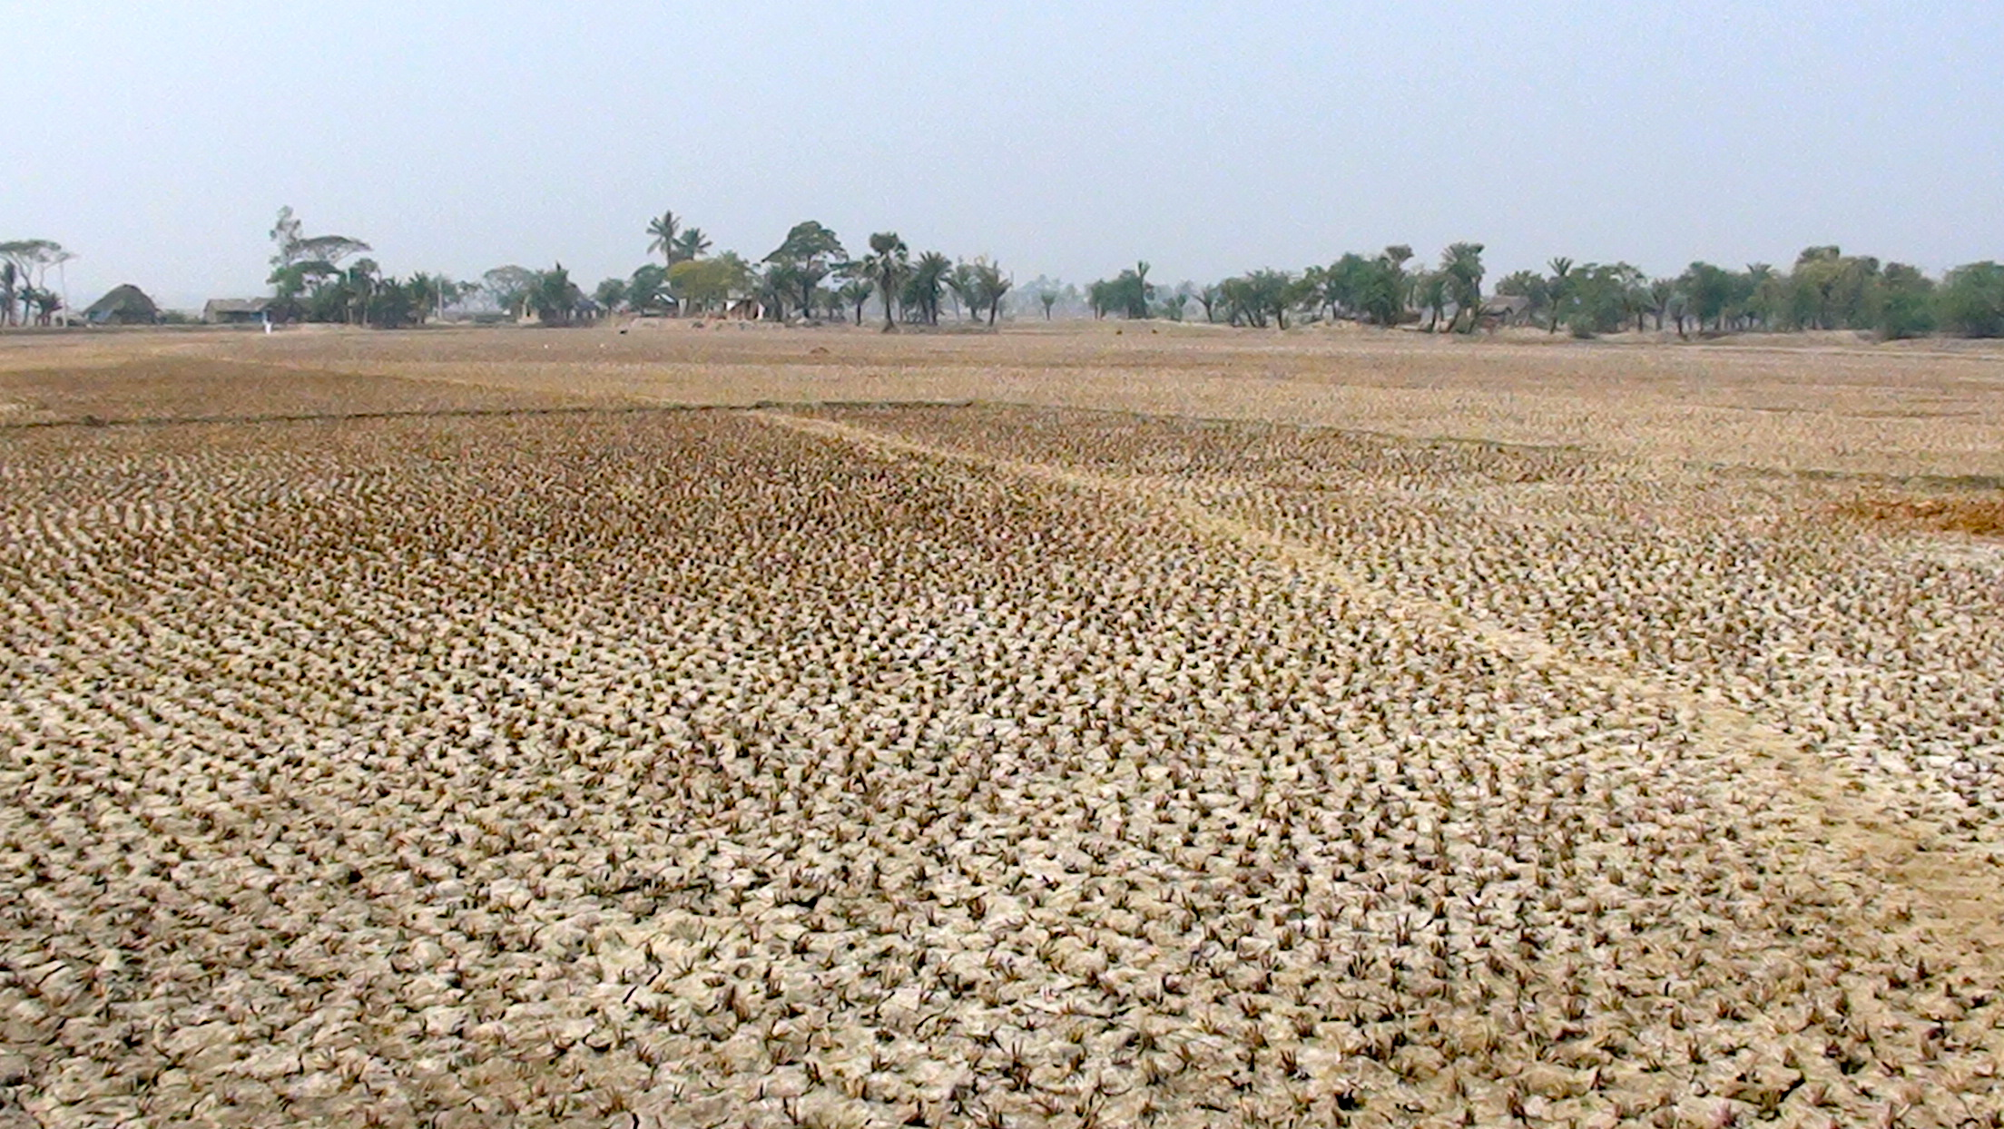

Slide 21
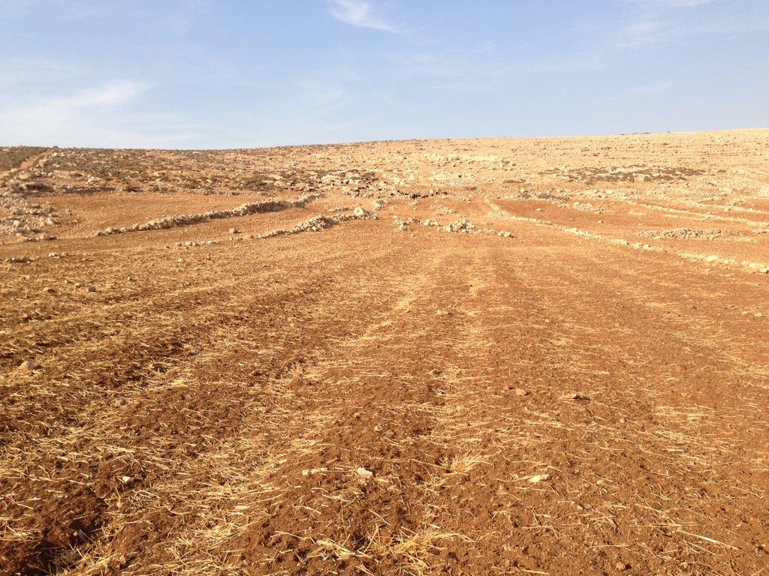

Slide 23
3.1 billion

Slide 24
“How, then, can they call on the one they have not believed in? And how can they believe in the one of whom they have not heard? And how can they hear without someone preaching to them? And how can they preach unless they are sent? As it is written, “How beautiful are the feet of those who bring good news!”
Romans 10:14-15, NIV

Slide 25


Slide 26
”I believe that one of the next great moves of God is going to be through believers in the workplace.”
Billy Graham

Slide 27
“The primary action of the church in the world is the action of its members in their daily work.”
Leslie Newbigin

Slide 28
“The harvest is plentiful, but the workers are few. Ask the Lord of the harvest, therefore, to send out workers into his harvest field.”
Luke 10:2-3, NIV

Slide 29
The Golden Rule
“For in everything, do to others as you would have them do to you, for this sums up the Law and the Prophets.”
Matthew 7:12, NIV

Slide 30
What is God asking
YOU to do?

