Slide 1
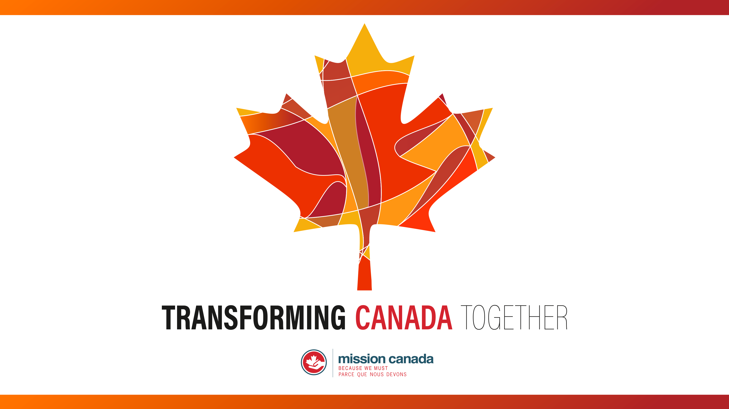
Notes:
Transforming Canada Together 2018

Slide 2

WHAT ABOUT SAMARIA?
Our Shared Mission in Canada
Notes:
WHAT ABOUT SAMARIA?
Our Shared Mission in Canada

Slide 3
WHAT ABOUT SAMARIA?
“But you will receive power when the Holy Spirit comes on you; and you will be my witnesses in Jerusalem, and in all Judea and Samaria, and to the ends of the earth.”
—Acts 1:8 NIV
Notes:
But you will receive power when the Holy Spirit comes on you; and you will be my witnesses in Jerusalem, and in all Judea and Samaria, and to the ends of the earth.” Acts 1:8 NIV

Slide 4
WHAT ABOUT SAMARIA?
Jerusalem – those close in proximity, close in culture
Judea – those distant in proximity, close in culture
Samaria – those close in proximity, different in culture and religion
Ends of the Earth – those distant in proximity, different in culture and religion
Notes:
We have tending to think of this in geography, where the challenge is more about those who are different than you and have a different worldview or perspective!
Jerusalem – those close in proximity, close in culture
Judea – those distant in proximity, close in culture
Samaria – those close in proximity, different in culture and religion
Ends of the Earth – those distant in proximity, different in culture and religion

Slide 5
Background:
Who were the Samaritans?
During the ministry of Jesus, the Samaritans were half-Jew, half-Gentile. The race came about after the Assyrian captivity of the northern kingdom of Israel in 721 B.C. Certain people from the nation of Israel stayed behind and intermarried with the Assyrians producing the Samaritans.
Notes:
Background: Who were the Samaritans?
During the ministry of Jesus, The Samaritans were half-Jew, half-Gentile. The race came about after the Assyrian captivity of the northern kingdom of Israel in 721 B.C. Certain people from the nation of Israel stayed behind and intermarried with the Assyrians producing the Samaritans.

Slide 6
1. They Had No Dealings With The Jews
We are told that the Jews had no dealings with the Samaritans. In a conversation that Jesus had with a Samaritan woman we are told that she said the following:
  Therefore the Samaritan woman said to him, "How is it that You, being a Jew, ask me for a drink since I am a Samaritan woman?" (For Jews have no dealings with Samaritans)—John 4:9 NASB
Notes:
They Had No Dealings With The Jews
We are told that the Jews had no dealings with the Samaritans. In a conversation that Jesus had with a Samaritan woman we are told that she said the following.
Therefore, the Samaritan woman said to him, "How is it that you, being a Jew, ask me for a drink since I am a Samaritan woman?" (For Jews have no dealings with Samaritans)—John 4:9

Slide 7
2. They Had Their Own Temple And Religious System
The Samaritans had their own temple, their own copy of the Torah – the first five books of the Old Testament - and their own religious system. There was an issue among the Jews and Samaritans as to where the proper place of worship was. The following exchange took place between Jesus and the Samaritan woman:
"Sir," the woman said, "I can see that you are a prophet. Our fathers worshiped on this mountain, but you Jews claim that the place where we must worship is in Jerusalem." Jesus declared, "Believe me, woman, a time is coming when you will worship the Father neither on this mountain nor in Jerusalem. You Samaritans worship what you do not know; we worship what we do know, for salvation is from the Jews. Yet a time is coming and has now come when the true worshipers will worship the Father in spirit and truth, for they are the kind of worshipers the Father seeks.—John 4:19-23 NIV
Notes:
2. They Had Their Own Temple And Religious System
The Samaritans had their own temple, their own copy of the Torah - the first five books of the Old Testament - and their own religious system. There was an issue among the Jews and Samaritans as to where the proper place of worship. The following exchange took place between Jesus and the Samaritan woman.
"Sir," the woman said, "I can see that you are a prophet. Our fathers worshiped on this mountain, but you Jews claim that the place where we must worship is in Jerusalem:" Jesus declared, "Believe me, woman, a time is coming when you will worship the Father neither on this mountain nor in Jerusalem. You Samaritans worship what you do not know; we worship what we do know, for salvation is from the Jews. Yet a time is coming and has now come when the true worshipers will worship the Father in spirit and truth, for they are the kind of worshipers the Father seeks (John 4:19-23).

Slide 8
3. They Rejected Jesus When He Passed Through Their Region
When Jesus was on his way to Jerusalem to die for the sins of the world he passed through Samaria. The Samaritans did not receive him because he was on his way to Jerusalem.
As the time approached for him to be taken up to heaven, Jesus resolutely set out for Jerusalem. And he sent messengers on ahead, who went into a Samaritan village to get things ready for him; but the people there did not welcome him, because he was heading for Jerusalem. —Luke 9:51-53
Notes:
2. They Rejected Jesus When He Passed Through Their Region
When Jesus was on his way to Jerusalem to die for the sins of the world he passed through Samaria. The Samaritans did not receive him because he was on his way to Jerusalem.
As the time approached for him to be taken up to heaven, Jesus resolutely set out for Jerusalem. And he sent messengers on ahead, who went into a Samaritan village to get things ready for him; but the people there did not welcome him, because he was heading for Jerusalem (Luke 9:51-53).

Slide 9
Summary
The Samaritans were a group of people who lived in Samaria – an area north of Jerusalem. They were half-Jews and half-Gentiles. When Assyria captured the northern kingdom of Israel in 721 B.C. some were taken in captivity while others left behind. The ones left behind intermarried with the Assyrians. Thus these people were neither fully Hebrews nor fully Gentiles.
The Samaritans had their own unique copy of the first five books of Scripture as well as their own unique system of worship. At the time of Jesus the Jews and the Samaritans did not deal with one another. Jesus, however, ministered to the people of Samaria preaching the good news to them.
Notes:
Summary
The Samaritans were a group of people who lived in Samaria – an area north of Jerusalem. They were half-Jews and half-Gentiles. When Assyria captured the northern kingdom of Israel in 721 B.C. some were taken in captivity while others left behind. The ones left behind intermarried with the Assyrians. Thus these people were neither fully Hebrews nor fully Gentiles. The Samaritans had their own unique copy of the first five books of Scripture as well as their own unique system of worship. At the time of Jesus the Jews and the Samaritans did not deal with one another. Jesus, however, ministered to the people of Samaria preaching the good news to them.

Slide 10
What about modern day Samaritans?
Our mission includes those that are modern day ‘Samaritans’ – the people groups in the challenging demographics or regions of our own country. We call those Mission Canada Priority Gaps.

Slide 11
Canada is a mission field.
In Canada in 2011, about 7.8 million people - 24% of the population - cite no religious affiliation, up 9% from a decade prior.

Slide 12
This means that 1 in 4 people in Canada have no connection to ANY religion.

Slide 13
What are the missional gaps in Canada?
The PAOC has identified five priorities in our shared mission:

Slide 14
1. New Canadians
We need to continue to reach our Neighbours and Newcomers
Notes:
1. New Canadians – We need to continue to reach our Neighbours and Newcomers
In the 2016 Census, Canada had 1,212,075 new immigrants who had permanently settled in Canada from 2011 to 2016. These recent immigrants represented 3.5% of Canada's total population in 2016. Asian countries accounted for 7 of the top 10 countries of birth of recent immigrants: the Philippines, India, China, Iran, Pakistan, Syria and South Korea.
New Immigrants are in following categories in 2016:
Economic immigrants 50.6%
Immigrants sponsored by family 24.1%
Refugees 24.1%
Other immigrants 1.2%
According to Statistics Canada's population projections, the proportion of Canada's foreign-born population could reach between 24.5% and 30.0% by 2036.
According to Canada's 2011 National Household Survey, there were 1,053,945 Muslims in Canada, or about 3.2% of the population, making Islam the second largest religion in the country after Christianity.
Luke reminds us in Acts 17:26-27
“And He made from one man every nation of mankind to live on all the face of the earth, having determined their appointed times and the boundaries of their habitation,²⁷ that they would seek God, if perhaps they might grope for Him and find Him, though He is not far from each one of us;
Many immigrants coming to Canada arrive without a relationship to Christ, which presents us with an incredible opportunity for friendship and ministry.
http://www.statcan.gc.ca/daily-quotidien/171025/dq171025b-eng.htm
Ibid
https://en.wikipedia.org/wiki/Islam_in_Canada

Slide 15
2. Next Generation Children, Youth, Campus
Notes:
2. Next Generation – Children, Youth, Campus
On July 1, 2015, estimates 5,749,400 children aged 0 to 14 years (16.0%).
Today's youth are unlike any generation before! They are more diverse, connected, socially engaged, and higher educated. There are over 9 million youth across the country, aged 15 to 34.
Enrolments in Canadian public postsecondary institutions (colleges and universities) totalled more than 2 million (2,054,943) in the 2014/2015 academic year, edging up 0.3% from the previous year and 10% are international students.
According to Pew Research, 29% of Canadians born between 1967 and 1986 have no religious affiliation as of 2011, 17 percentage points higher than Canada’s oldest living generation (born 1946 or earlier) and nine points higher than Canadians born between 1947 and 1966. Canadians born between 1987 and 1995 – which includes the youngest generation of adults, who are still coming of age – have rates of disaffiliation like the previous generation of Canadians (29% unaffiliated, as of 2011)
This means we must continue to work with the upcoming generation to engage them with the message of the Gospel in a language that they understand.
http://www.statcan.gc.ca/pub/11-631-x/11-631-x2018001-eng.htm
http://www.statcan.gc.ca/daily-quotidien/161123/dq161123b-eng.htm
http://www.pewforum.org/2013/06/27/canadas-changing-religious-landscape/

Slide 16
3. Quebec and Francophone Canada
Notes:
3. Quebec and Francophone Canada
Almost 10 million Canadians converse in French. That is 30.1% of the population (Stats Canada, 2011), approximately 7.3 million people reported French as their mother tongue in Canada and over one million Francophones outside of the province of Quebec.
Despite its nominally Christian majority, Montreal and the larger Quebec Province are among the most under-evangelized regions of North America. A 2008 Léger poll found that only 6 percent of Quebec's 6 million Catholics attended weekly Mass, down from 90 percent in the 1960s. About 7 percent of Quebecers are Protestants, and less than 1 percent identify as evangelical.
In 1986, nearly half (48%) of Quebec residents said they attended religious services at least once a month. By 2011, about one-in-six Quebecers (17%) reported attending religious services at least once a month, a drop of 31 percent.
The evangelical church in Quebec continues to slowly grow, yet is only keeping up to birthrates and immigration.
http://www12.statcan.gc.ca/census-recensement/2011/as-sa/98-314-x/98-314-x2011003_1-eng.cfm
http://www.christianitytoday.com/ct/2012/may/quebec-prodigal-province.html
http://www.pewforum.org/2013/06/27/canadas-changing-religious-landscape/

Slide 17
4. Indigenous Canadians
Notes:
4. Indigenous Canadians – We partner with our indigenous leaders in mission.
According to the 2016 Census, 1,673,785 (4.9%) of Canada’s total population where considered Indigenous. (977,230 First Nations, 587,545 Metis, and 65,025 Inuit) This would be a growth of 42.5% in the past 10 years (2006-2016). The average age is almost a decade younger at 32.1 years than the non-aboriginal population. There are 12 metropolitan centres with an indigenous population over 10,000.
We continue to partner with our indigenous leaders to advance the Gospel in small communities and centres with large aboriginal populations.

Slide 18
5. Urban Centres
Notes:
5. Urban Centres
The 2016 census shows that 82 per cent of Canadian population live in large and medium-sized cities across the country, one of the highest concentrations among G7 nations. The three biggest metropolitan areas in the country — Toronto, Montreal and Vancouver — are now home to more than one-third of all Canadians with a combined population of 12.5 million,
This is a unique challenge as we have primarily been a suburban and rural movement and yet we are seeing increasing gentrification into our urban cores.
We need to ask the Lord to raise urban workers that would reengage in our rapidly growing urban centres.

Slide 19
CONCLUSION
Notes:
Conclusion:
We need to think like missionaries as we engage our neighbours and friends close in proximity, different in culture and religion. We must understand that they are often without a biblical story of reference.
We are calling on Canadians to spend themselves on behalf of the Gospel in one of these missional areas through Mission Canada.
We are the testimony of Christ to them. Why? Because we must!

